Slide 1

BabyCare System Project milestone 1
Surveillance & Locating System Resolution
Wireless Sensor Networks
Fan Zhang, Yu Wang, Ying Liu

Slide 2
Project purpose
  We are aiming to develop a BabyCare system
  using Wireless Sensor Network to keep the kids playing within specific safe region
  Main Functions:
Automatically locating the kids periodically
Identify the dangerous movement with suspected movement
Warning the parents by Alarm when kid goes out of range

Slide 3
Preparation
To prepare the project,
1. We configured the system
2. Tried Blink
3. learned Tinyos and nesc

Slide 4
System Architecture
3 parts, emitter -> fowarder -> base station
emmiter
Emitter is held by the user. It broadcasts packets to the 4 forwarders periodically.

Slide 5
System Architecture
Forwarder
Forwarder will be located in the every corner of the yards to accept the data coming from emitter, wrap it in a package and forward it to the base station.

Slide 6
System Architecture
Base station
Base station is connected to the computer. It collects data from all of the 4 forwarders and sends it to the java application, output the result.

Slide 7
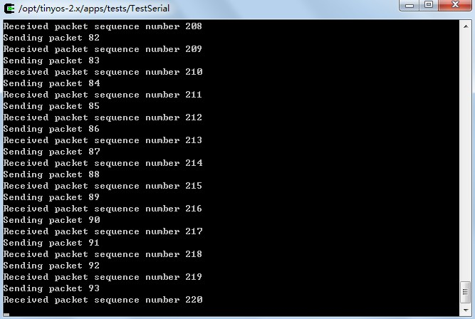
some results – for this phase we use TestSerial to show the data we got

Slide 8
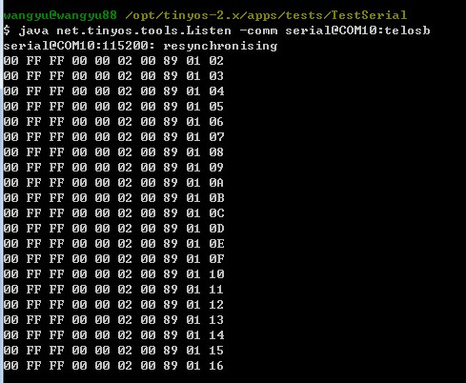
some results

Slide 9
Problems
We still got some problems to solve...
1. how to locate the people, algorithm?
2. how to tell that the child go outside the yard or go inside the house
3. Minor problem of Base station code.
Notes:
get these done before milestone2

